Slide 1
E-Game Green Salon
Status update and testing

Slide 2
In this presentation:
Progress
Translations (partially) included
Game is now Multilanguage
Next Steps (now)
Testing (with students)
Later Steps
Translations of ‘buttons’ + manual
Finishing feedback report

Slide 3
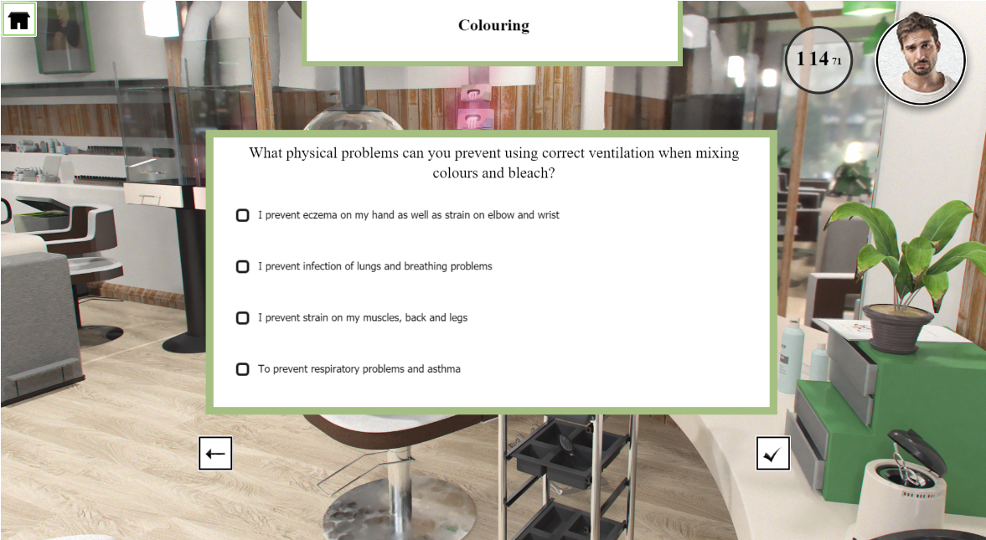
The game (test version) is at http://haircut.crumiano.com

Slide 4
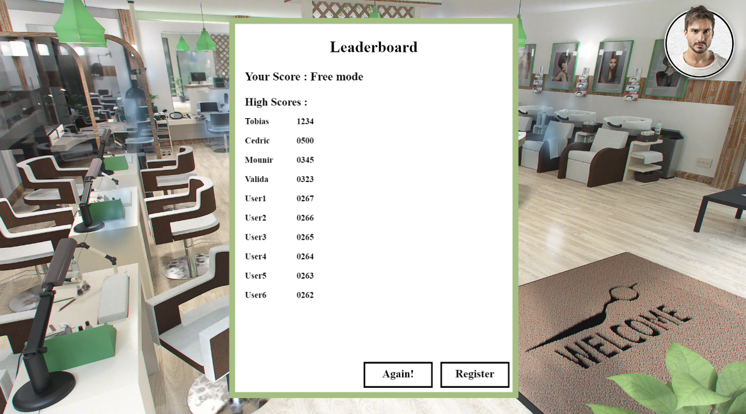
When a player is done

Slide 5
Students
Indicate errors
Indicate what instruction text they need (this will make the manual)
Final steps
Fix errors in text
Create manual (and translate it)

Slide 6
Thank you for your attention!

